Slide 1


Slide 2
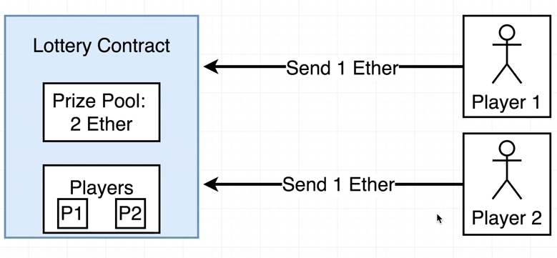
More advanced contract

Slide 3
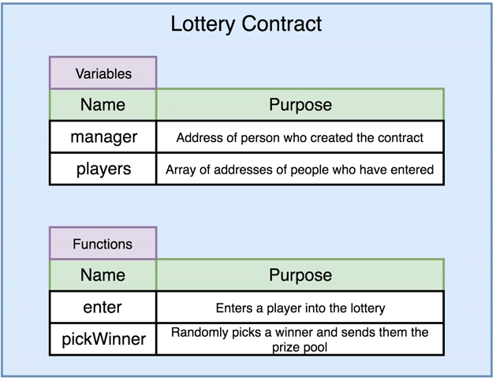
Lottery Contract

Slide 4
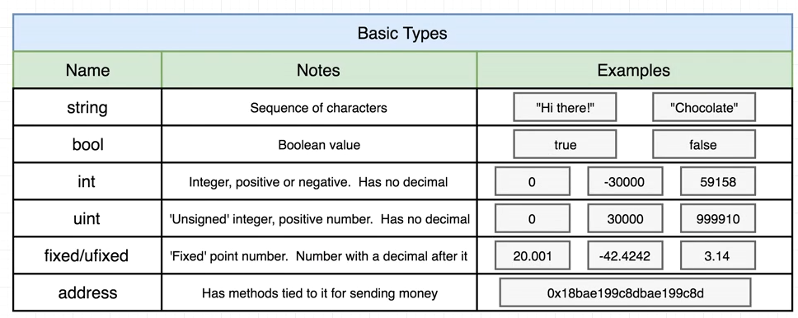
Basic value types in solidity

Slide 5
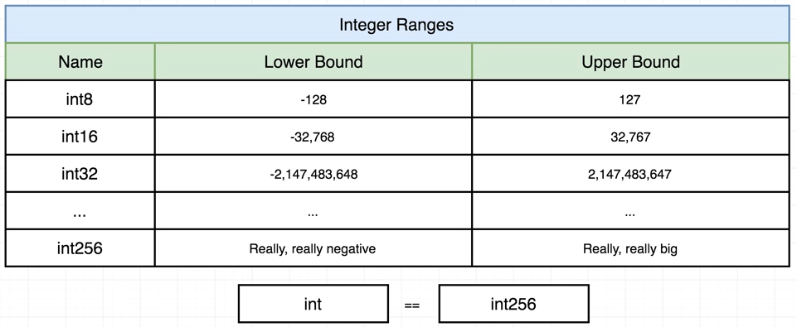
Int and uint
For uint the lower bound is always zero.

Slide 6
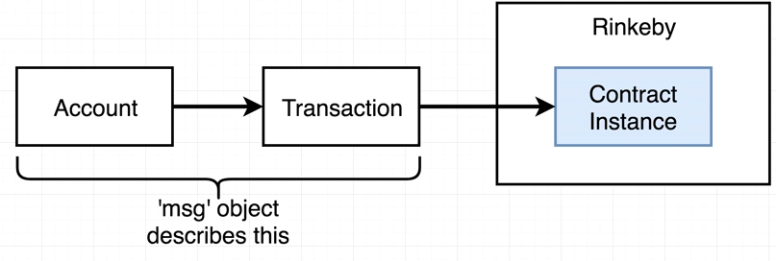
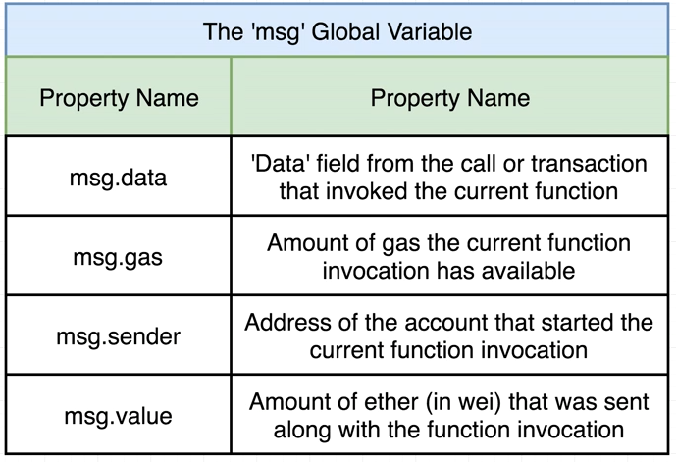
Msg global variable
Msg is a magical global variable that is present in all the functions of the contract and can be accessed anywhere without any declaration. It is available for both function calling and sending transaction.

Slide 7
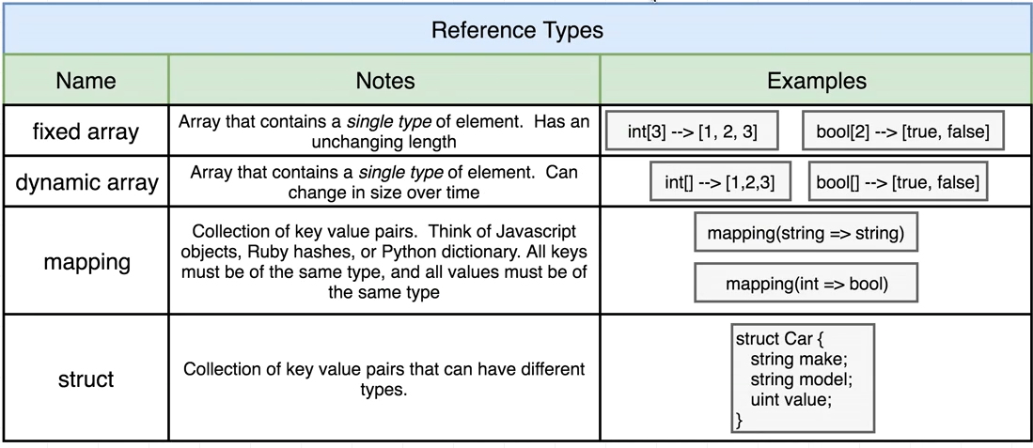
Basic reference types

Slide 8
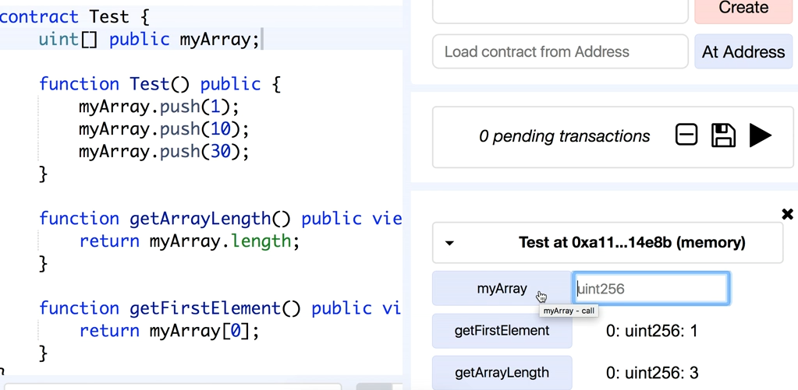
How arrays work in solidity

Slide 9
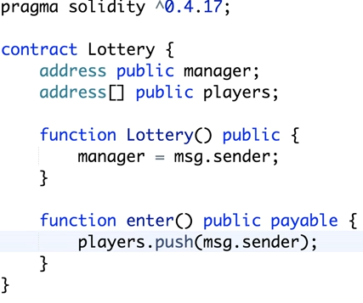
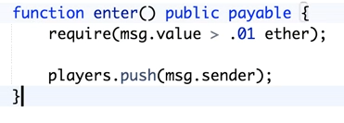

Lottery contract contd..
Require keyword does the work of if..else

Slide 10
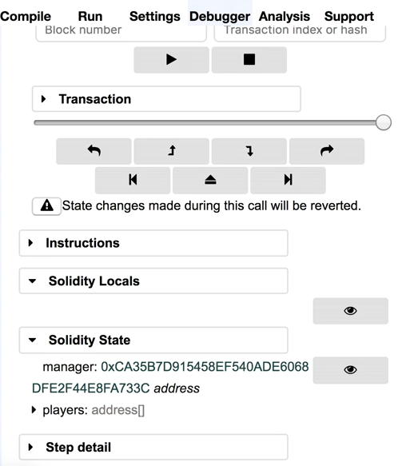
Remix debugger

Slide 11
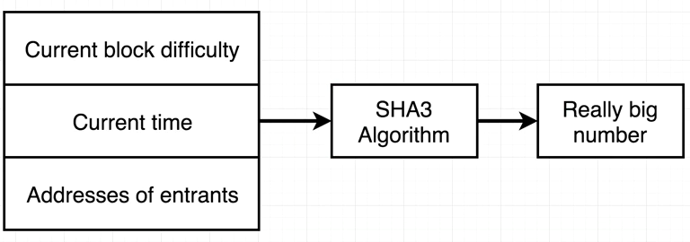


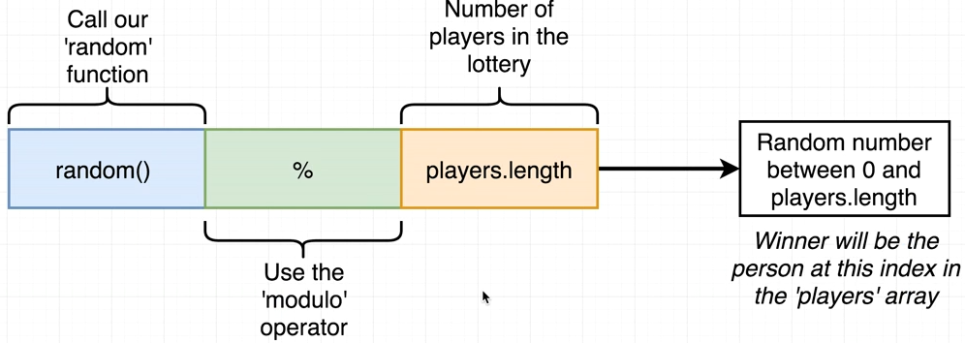
Picking a winner
1
2
4
3

Slide 12
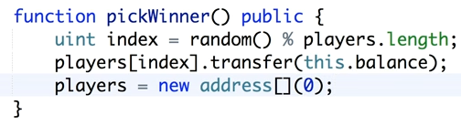
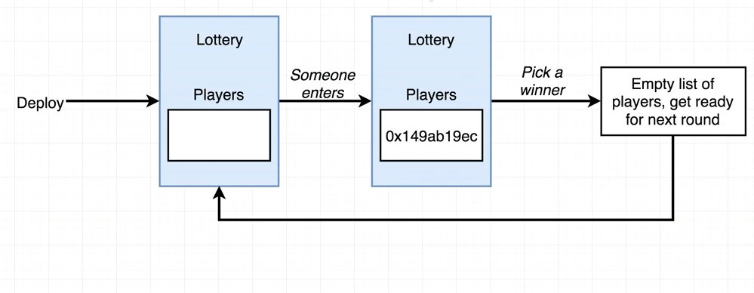
Sending money to winner and resetting the contract

Slide 13
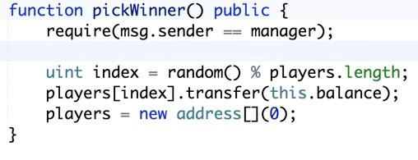
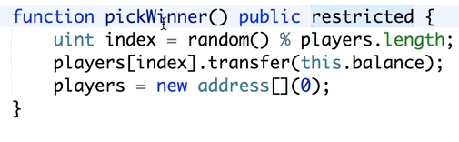
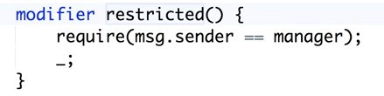
Only manager can call pick winner
Modifiers are uses to prevent
Writing repeated lines of code. If we want to write any other function that can be run only by the manager then we can simply use restricted modifier.
or

Slide 14
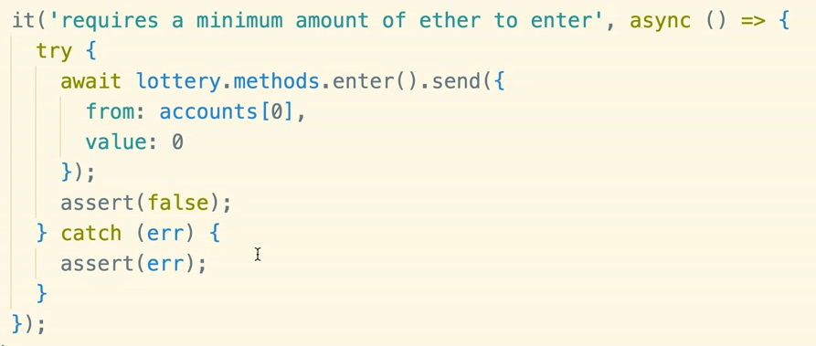
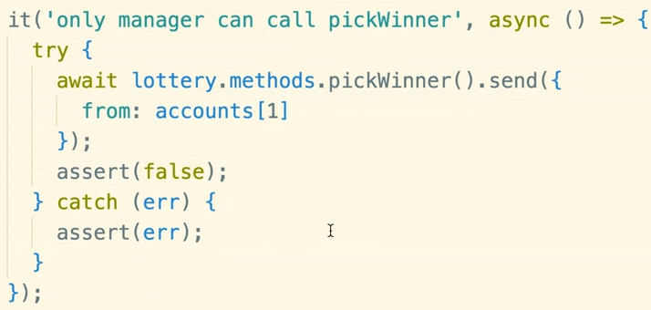
Simple mocha tests for lottery

